Slide 1




Inventory Management System

Slide 2



Meet Our Team
Mohammed Abdulghany
Ziad elsayed elbrolosy
Omar Nour Eldin
Ahmed wagih salem
Sherif eleraky
Nada Ezzeldien

Slide 3
Introduction
As digital commerce continues to expand, many small and medium-sized businesses face challenges in establishing efficient and comprehensive online sales platforms. These businesses often rely on outdated, fragmented systems that complicate product management, customer engagement, and transaction processing. Such inefficiencies lead to operational delays, increased costs, and customer dissatisfaction.
Furthermore, current systems frequently lack seamless integration across critical sales channels, from inventory management to secure payment processing. This results in missed sales opportunities and an inability to meet evolving consumer expectations in an increasingly competitive marketplace.
This project proposes the development of a web-based eCommerce and sales system that provides businesses with an all-in-one solution. The platform will focus on simplifying product management, streamlining order processing, and enhancing customer satisfaction through a smooth, intuitive shopping experience. By offering these integrated features, the system will help businesses optimize operations and maximize their online sales potential.

Slide 4


SYSTEM SERVICES
User managment
Category
&
Products
Purchase
Shoppping
Cart

Slide 5

Tools & Techniques

Slide 6







Tools & Techniques
EntityFramework
Linq

Slide 7
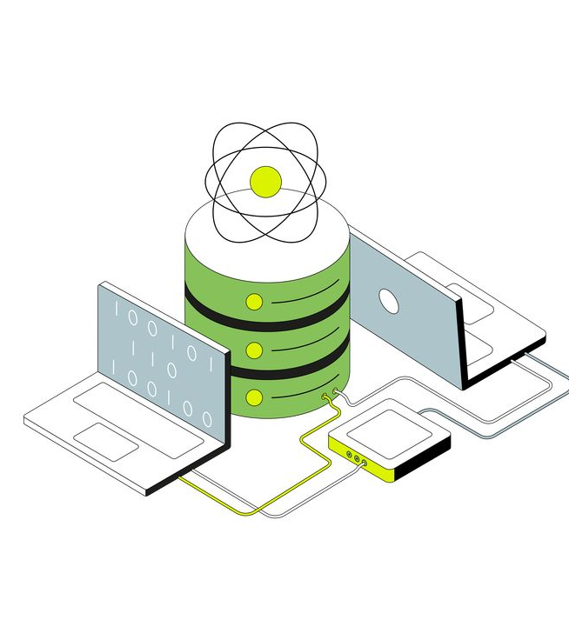
SYSTEM Database

Slide 8
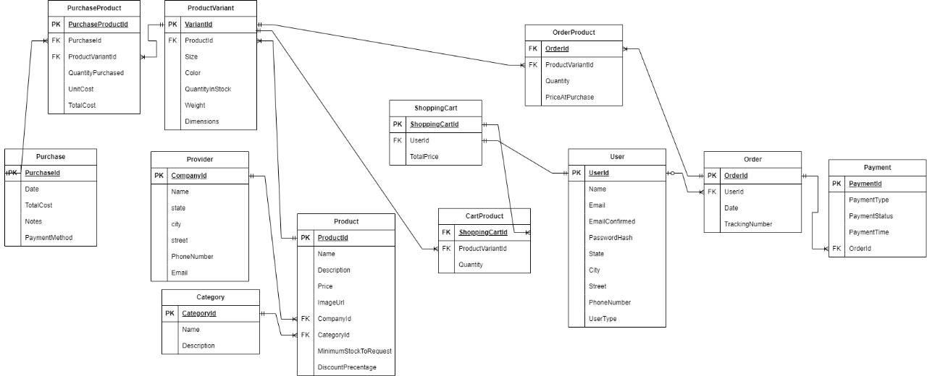
SYSTEM Database

Slide 9

Info database
3

Slide 10





Tables
User Table
Product Table
Category Table
Provider Table
CompanyId: Primary key to uniquely identify each provider.
Name, State, City, Street: Provider's company address information.
PhoneNumber: Provider's phone number.
Email: Provider's email address.
UserId: Primary key to uniquely identify each user.
Name: The user's name.
Email: The user's email address.
EmailConfirmed: Indicates whether the email is confirmed.
PasswordHash: Hashed password for security.
State, City, Street: User's address information.
PhoneNumber: User's phone number.
UserType: Defines the user type (e.g., customer, admin).
ProductId: Primary key to uniquely identify each product.
Name: The name of the product.
Description: A detailed description of the product.
Price: The product's price.
ImageUrl: URL to the product's image.
CategoryId: Foreign key to the product category.
CompanyId: Foreign key to the product provider.
MinimumStockToRequest: Minimum stock level for orders.
DiscountPercentage: Discount applied to the product.
CategoryId: Primary key to uniquely identify each category.
Name: The name of the category.
Description: A description of the category.

Slide 11



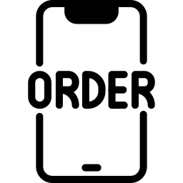
Tables
ProductVariant Table
Purchase Table
PurchaseProduct Table
Order Table
OrderId: Primary key to uniquely identify each order.
UserId: Foreign key to the user who placed the order.
Date: Date the order was placed.
TrackingNumber: Number used to track the order.
VariantId: Primary key to uniquely identify each product variant.
ProductId: Foreign key to the product.
Size, Color, QuantityInStock, Weight, Dimensions: Specific details for the product variant, including size, color, stock quantity, weight, and dimensions
PurchaseId: Primary key to uniquely identify each purchase.
Date: Date of the purchase.
TotalCost: Total cost of the purchase.
Notes: Additional purchase notes.
PaymentMethod: Method used to make the payment.
PurchaseProductId: Primary key for each purchase-product record.
PurchaseId: Foreign key to the purchase.
ProductVariantId: Foreign key to the product variant.
QuantityPurchased: Number of units purchased.
UnitCost: Cost per unit.
TotalCost: Total cost for this purchase.

Slide 12




Tables
OrderProduct Table
ShoppingCart Table
CartProduct Table
Payment Table
OrderId: Foreign key to the order.
ProductVariantId: Foreign key to the product variant.
Quantity: Number of products ordered.
PriceAtPurchase: Price of the product at the time of the purchase.
ShoppingCartId: Primary key to uniquely identify each shopping cart.
UserId: Foreign key to the user who owns the cart.
TotalPrice: Total price of the products in the cart.
PaymentId: Primary key to uniquely identify each payment.
OrderId: Foreign key to the related order.
PaymentType: Method of payment (e.g., credit card, PayPal).
PaymentStatus: Status of the payment (e.g., paid, pending).
PaymentTime: Time when the payment was made.
ShoppingCartId: Foreign key to the shopping cart.
ProductVariantId: Foreign key to the product variant.
Quantity: Quantity of the product in the cart.

Slide 13


Relations
Order - Payment
Order can have one associated Payment, and each Payament is linked to a single Order.
Represented by the OrderId foreign key in the Payment table.
3
User - ShoppingCart
Each User can have one ShoppingCart, and each ShoppingCart belongs to one User.This is represented by the UserId foreign key in the ShoppingCart table.

Slide 14
Relations
One User can place many Orders, but each Order belongs to only one User.
Managed via the UserId foreign key in the Order table.
User - Order
One Order can contain multiple OrderProduct records, but each OrderProduct is linked to only one Order.
Represented by the OrderId foreign key in the OrderProduct table
Order - OrderProduct
3
Product - ProductVariant
One Product can have many ProductVariant records (e.g., different sizes or colors), but each ProductVariant is tied to only one Product.
Managed via the ProductId foreign key in the ProductVariant table.
One ShoppingCart can contain multiple CartProduct records, but each CartProduct belongs to only one ShoppingCart.
Represented by the ShoppingCartId foreign key in the CartProduct table.
ShoppingCart - CartProduct
Category - Product
One Category can have many Products, but each Product belongs to only one Category.
Managed via the CategoryId foreign key in the Product table.

Slide 15
Relations
Provider - Product
One Provider can supply many Products, but each Product is tied to only one Provider.
Represented by the CompanyId foreign key in the Product table.
3
One Purchase can involve multiple PurchaseProduct records, but each PurchaseProduct belongs to only one Purchase.
Managed via the PurchaseId foreign key in the PurchaseProduct table.
Purchase - PurchaseProduct

Slide 16

Quick look for
project
3

Slide 17
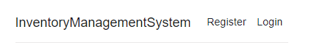
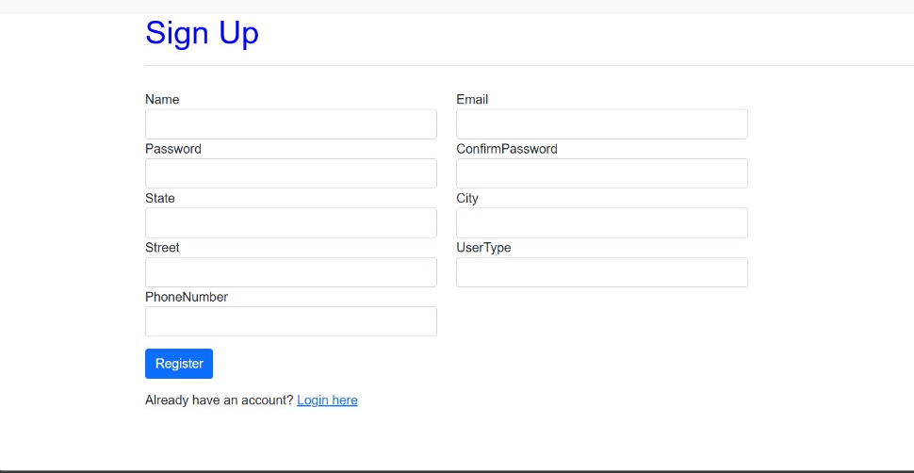
First, Register
To start using the system, users must first register by following these steps:
Navigate to the Registration Page: On the home page of the Inventory Management System, click on the 'Register' link at the top right corner. This will take you to the user registration form.
Fill Out the Registration Form:
Name: Enter your full name.
Email: Provide a valid email address.
Password: Create a secure password and confirm it in the 'Confirm Password' field.
Street, City, State: Fill in your address details.
Phone Number: Enter a valid phone number for contact purposes.
User Type: Select the appropriate user type from the dropdown (e.g., Admin, Customer, etc.).
Submit the Form: Once all the fields are filled in correctly, click the 'Register' button to complete your registration. If you already have an account, you can click on 'Login here' to proceed to the login page.

Slide 18
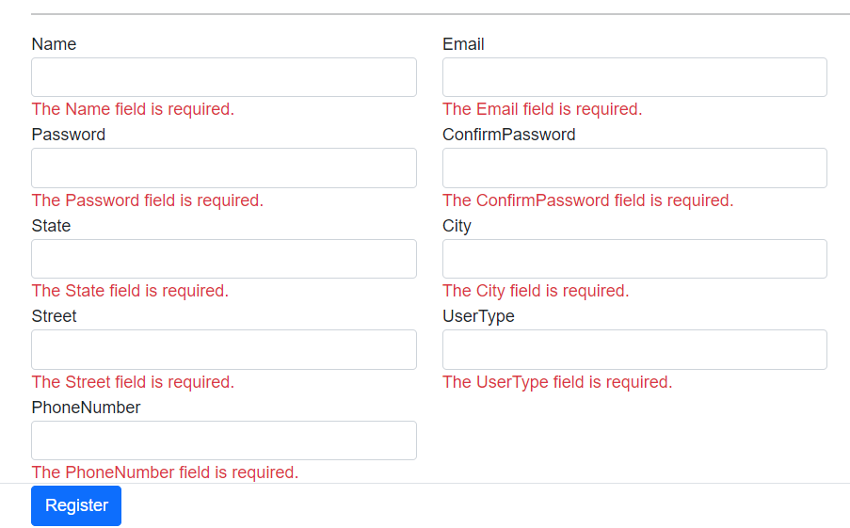
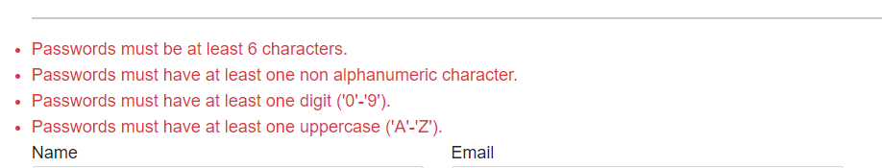
Register Validation
Required Fields: If any required field is left empty, the form will not be submitted, and you will see a red error message specifying which field needs to be completed.
Password Validation: For security, the password field has additional validation rules:
The password must be at least 6 characters long.
It must contain at least one alphanumeric character.
It must include at least one digit (0-9).
It must have at least one uppercase letter (A-Z).
Confirm Password: The value in the “Confirm Password” field must exactly match the password you entered in the “Password” field. If it doesn’t, you will receive a validation error.

Slide 19
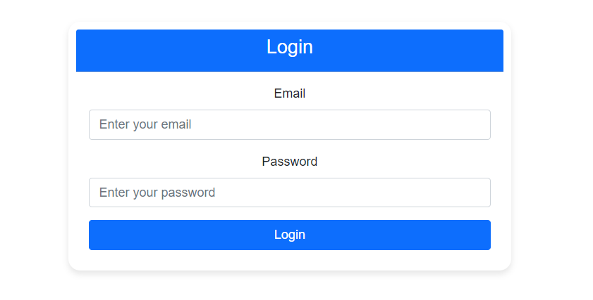
After Register
After completing the registration, the user is automatically redirected to the Login page. Here, they can enter their Email and Password to access the system. This ensures that only registered users can log in and start using the Inventory Management System securely. If the login is successful, the user will be directed to their dashboard where they can manage their tasks.
After successfully logging in, the user is redirected to the Home Page. On this page, the user’s name is displayed at the top to confirm their identity. Additionally, a Logout button is available, allowing the user to securely log out of their account when they are done using the system. This ensures a smooth and secure user experience.

Slide 20
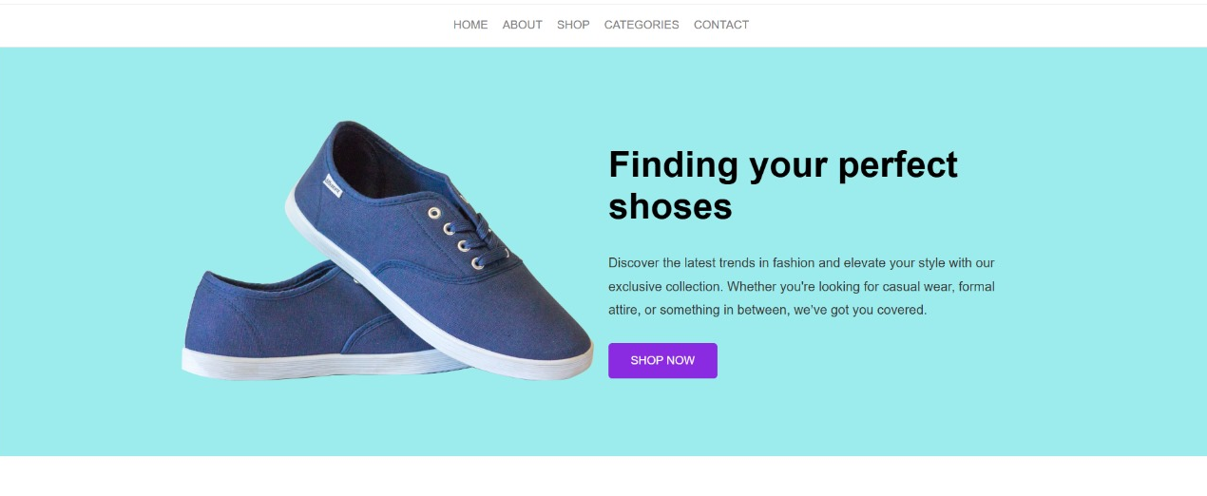
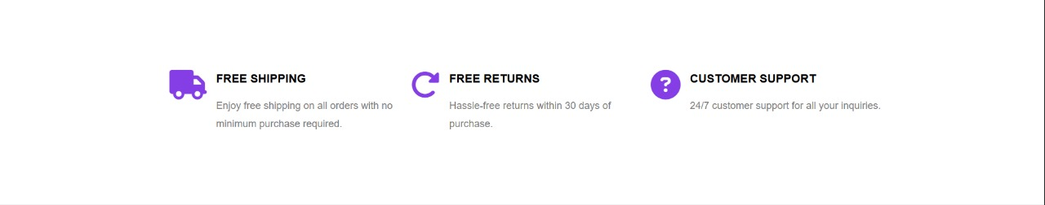
Home Page

Slide 21

Category

Slide 22
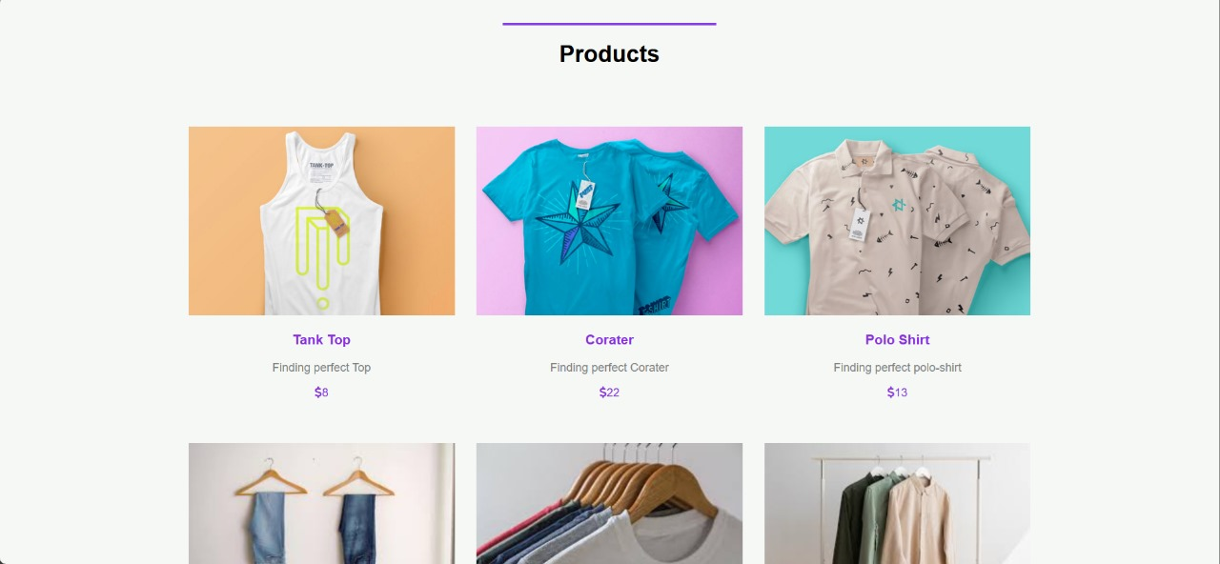
Product

Slide 23
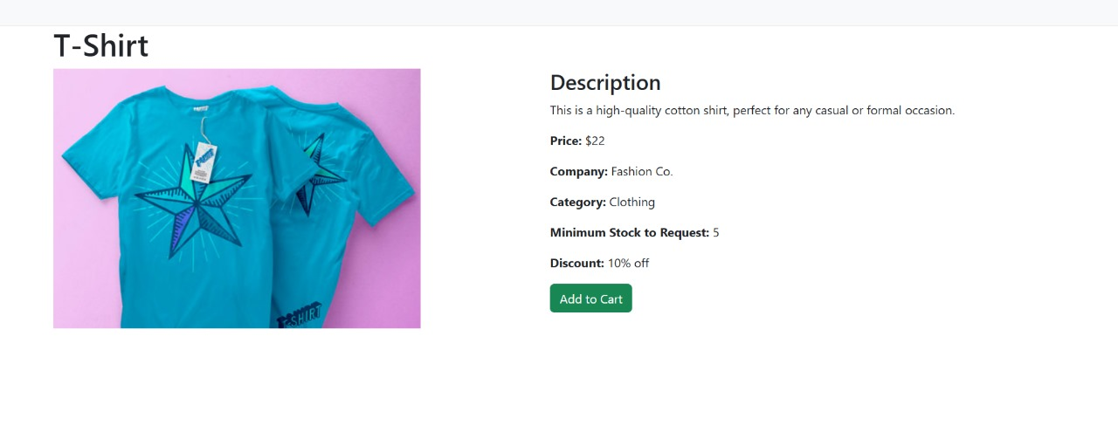
Details

Slide 24
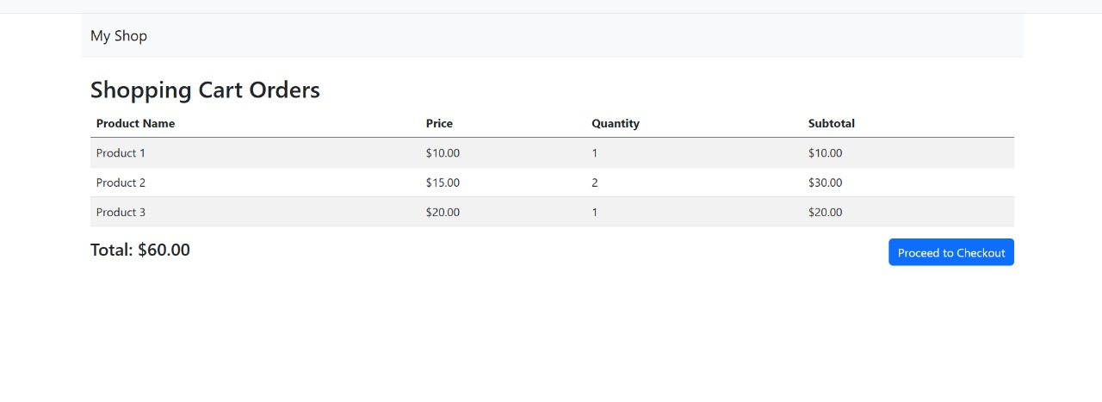
Shopping Cart

Slide 25
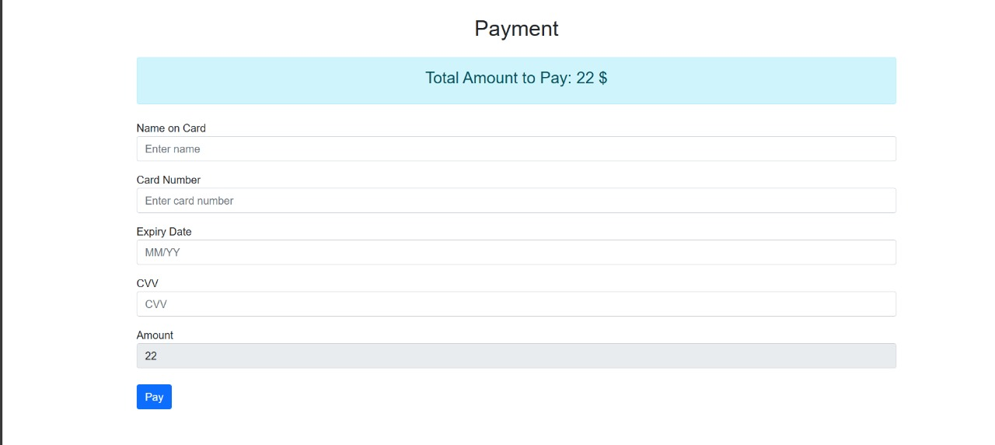
Payment

Slide 26

Deployment
3

Slide 27
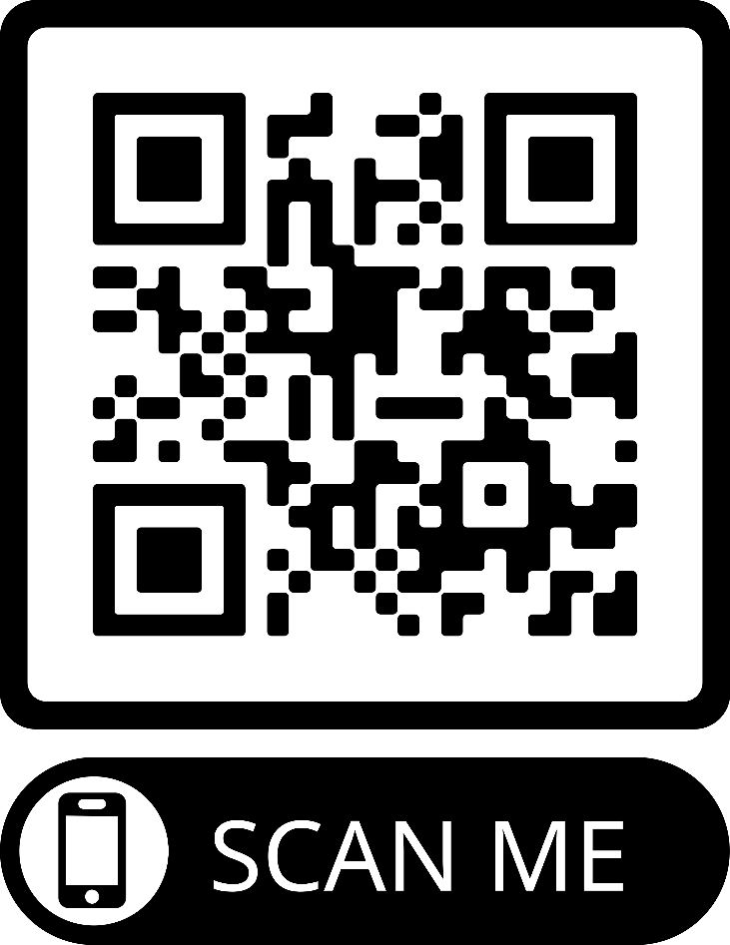

Deployment

Slide 28

Thank
You

